Slide 1
Byiringiro felecien
Gakuru karim

Slide 2
Cardiovascular system

Slide 3
Introduction to cardiovascular system
Cardiovascular system as the name imply consist of heart and blood vessels.
Heart act as a pump where as bood is just pumped into the blood vessels throughout the body
Three types of blood vessels are:arteries,arterioles,capillaries,venules and veins described in order of the path followed by blood in circulation from the heart.
Circulation is either pulmonary or systemic circulation

Slide 4
Cardiovascular system:heart
heart is the mascular pump of the bood located in the thoracic cavity anterior to the vertebral column and posterior to the sternum.
It is made up of four chambers,two atria superiorly and two others on its inferior side.
It is made up of three main layers:outer being pericardium,middle is myocardium and inner being endocardium.
Pericardium protect it,myocardium contract to pump blood and endocardium line heart chambers.

Slide 5
Heart chambers
We have right atrium and right ventricles on the right side of the heart upper and lower respectively.
Right atrium bring venous blood to the heart but right ventricle carry blood away from the heart to the lung to remove co2 and add o2 to the blood.
Heart also have left atrium and left ventricle,wher former bring blood from lung to the heart and latter pump blood from the heart to all body parts.

Slide 6
Cardiovascular system:blood vessels
Main blood vessels are arteris,capillaries and veins.
All transport blood but have structural differences.
Artery is very thick where as vein is thin and capillaries being only single cell thick thus act as exchange site for nutrients between blood and tisswe fluid.
Arteries carry blood away from the heart where veins carry it toward the heart and vein link the two.

Slide 7
blood
Blood is the liquid that is circulating in cardiovascular system
It is composed of formed elements and plasma
It is pressurized in vessels by heart

Slide 8
Pulmonary and systemic circulation
As mentioned above,blood move from the heart to lung and then back to heart,this comprise pulmonary circulation.here blood moves from rigt ventricle pumped to lung back enter right atrium hence complete pulmonary cicuit.
During systemic circulation,blood is pumped right from left ventricle through large artery called aorta pass through capillaries into veins then enter heart again through right atrium competing systemic circulation.

Slide 9
Clinical application:hypertension
Hypertension refers to high pressure exerted by blood as it passes through arterial system
It is caused by increased pumping action of the heart due to many reasons like uncoordinated neura stimulation,obstacles to the flow of blood through the vessels and obesity
Patients with this cardiovascular disorder are recommended to take meal that is not highly rich in fats to avoid obesity and agin should engage in physical exercises like jogging,dancing,running and even swimming.

Slide 10
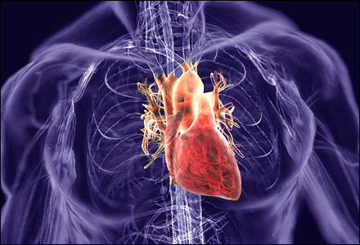

Slide 11
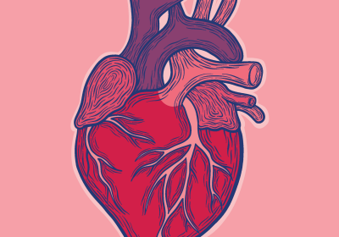
Structure of heart
As it is shown,looking heart anteriorly you can not see the attachmemt of vessels but you can only see them on superior emerging from heart

Slide 12
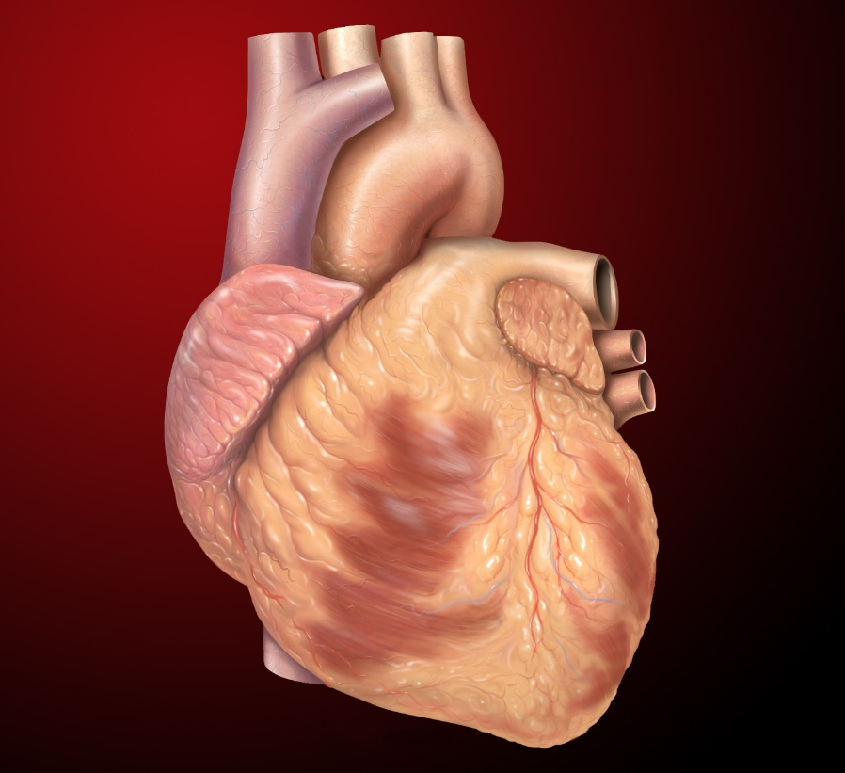
Con,t

Slide 13
List of risk foctors associated with heart
Smoking
Genetic disorder
Physical inability

Slide 14
End topic summary
Cardiovascular system like all other body systems have organs which are heart and vessels attached to it generally.
Heat have three layers and four chambers
It is of clinical importance to keep your heart health by exercising regularly
Eating wisely avoid cardiovascular system related disorder.

Slide 15
referances
Hole’s human anatomy and physiology
Essentials of anatomy

